Slide 1




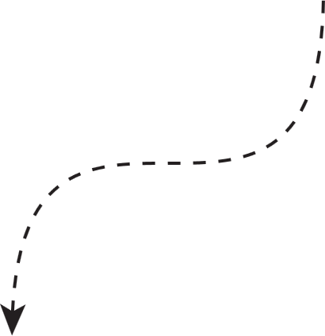
By Olivia Wilson
IT and Emerging Technologies

Slide 2










Let's know each other...
ICE
BREAKER
What's your favorite color?
What's your favorite film?
What’s your favorite season?
Favorite social media app?
What's your favorite food?
What's your favorite city?
Summer or winter?
What’s your favorite sport?
My favorite food
My favorite film
My favorite city

Slide 3



Agenda
Explain the impact of emerging technologies on organizations.
Discuss examples of digital disruption.
Understand IT governance and risk management.
Identify common reasons for IT project failures.
Recognize key emerging technologies shaping business today.
Understand the ethical implications

Slide 4

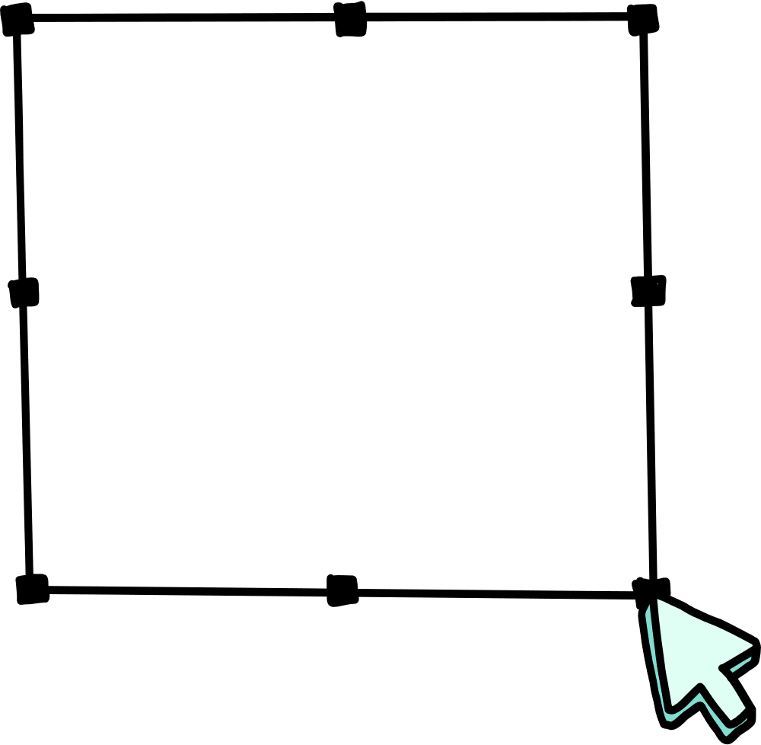



What is Digital Disruption?
“The effect that changes the fundamental expectations and behaviors in a culture, market, industry, or process through digital capabilities.”
- Uber – owns no cars
- Airbnb – owns no real estate
- Alibaba – holds no inventory
Some examples

Slide 5


IT Governance is the framework and processes that ensure an organization’s IT systems and strategies support its overall business goals, value delivery, and compliance requirements.
Why IT Projects Fail
MAIN REASONS
1
Not understanding the technology
2
Not understanding business needs
IT Risk Management involves identifying, assessing, and controlling risks that could negatively affect an organization’s information systems, data, and operations.
3
Expecting a 'silver bullet' solution.
4
Poor project scope definition.
5
Lack of stakeholder buy-in.

Slide 6
AI
AR/VR
AI – Decision-making, automation
Immersive training experiences.
Key Emerging Technologies
Blockchain
Cybersecurity
Secure transactions
Protecting digital assets
Large Language Models
Metaverse
Virtual economies
Advanced tasks

Slide 7
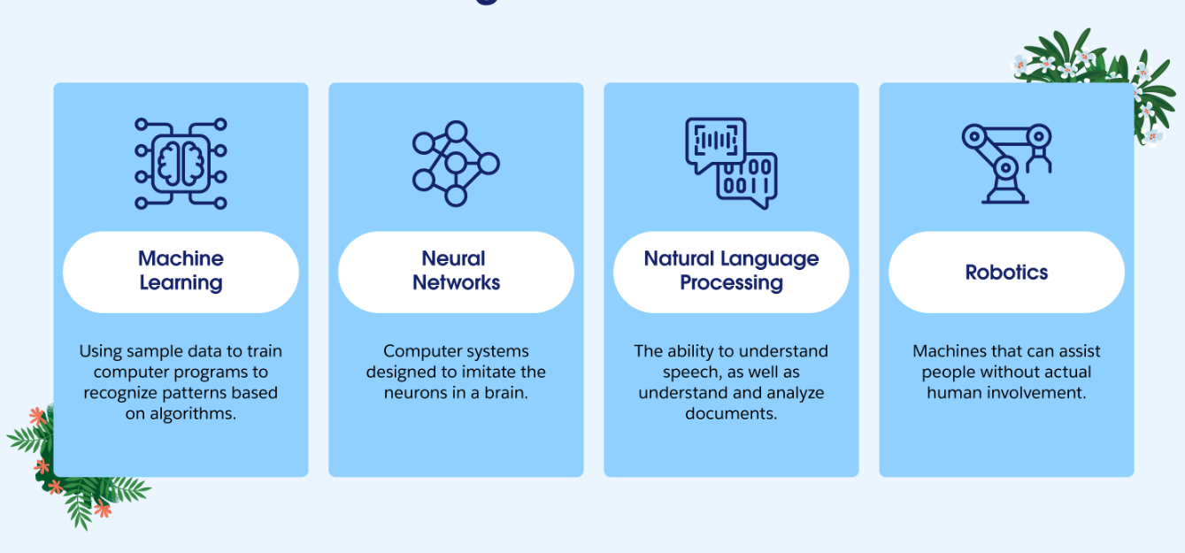
Artificial Intelligence
.
AI is a computer systems designed to simulate human intelligence by performing tasks like learning, problem-solving, and decision-making.

Slide 8




.
Better Productivity
Smart Factory
AI handles repetitive tasks.
Workers focus on skilled jobs.
Uses AI and robots to
automate production.
Increases efficiency and
production capacity.
Artificial Intelligence
Sustainability
Industry Leadership
Uses solar panels.
Reduces environmental impact.
Sets an example in using AI among competitors.
Shows the value of technology for modern businesses.

Slide 9
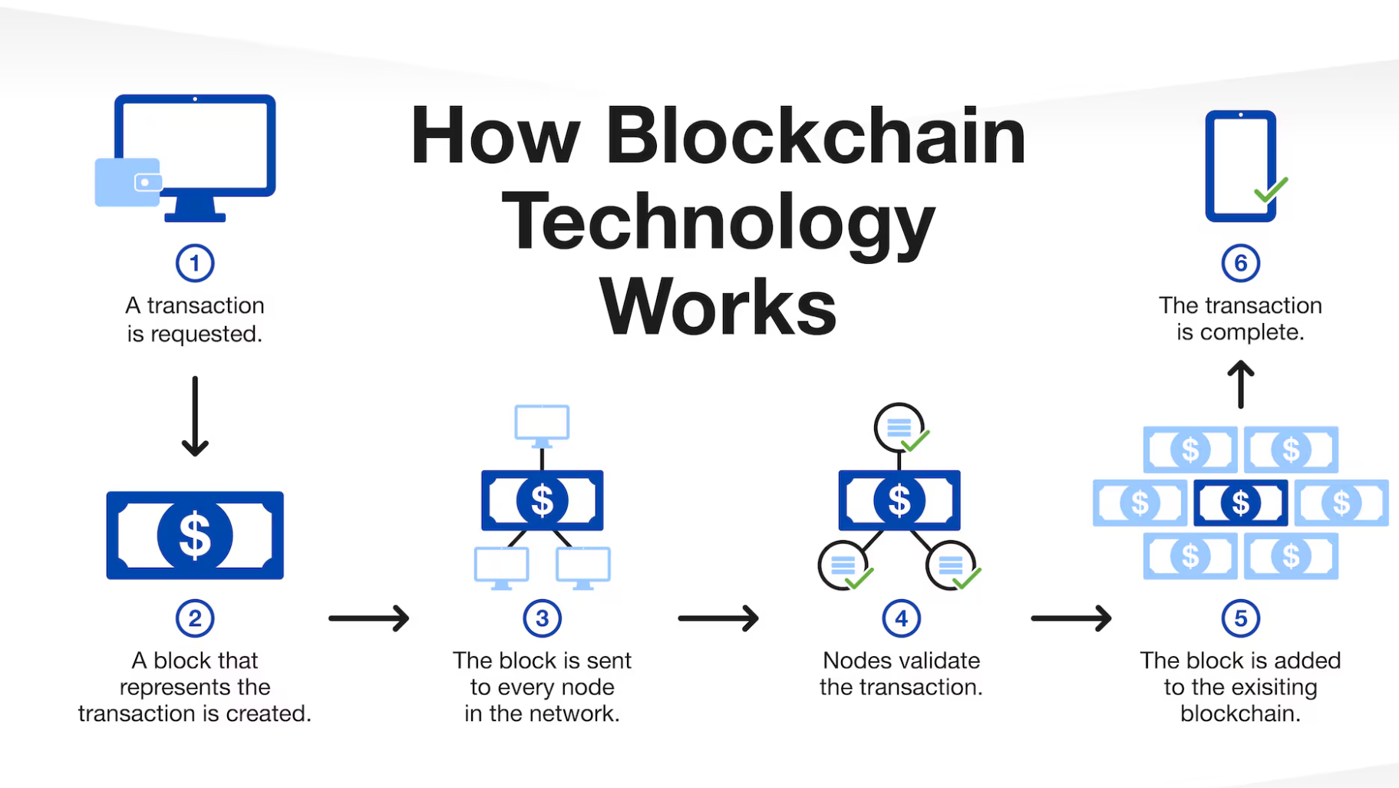
Blockchain
Blockchain is like a shared notebook that everyone can see and write in, but no one can erase or change past entries — making it a trusted record of information.
Notes:
Because the information is shared and verified by multiple participants (called nodes) rather than controlled by a single authority, it is tamper-resistant, trustworthy, and difficult to alter once recorded.

Slide 10
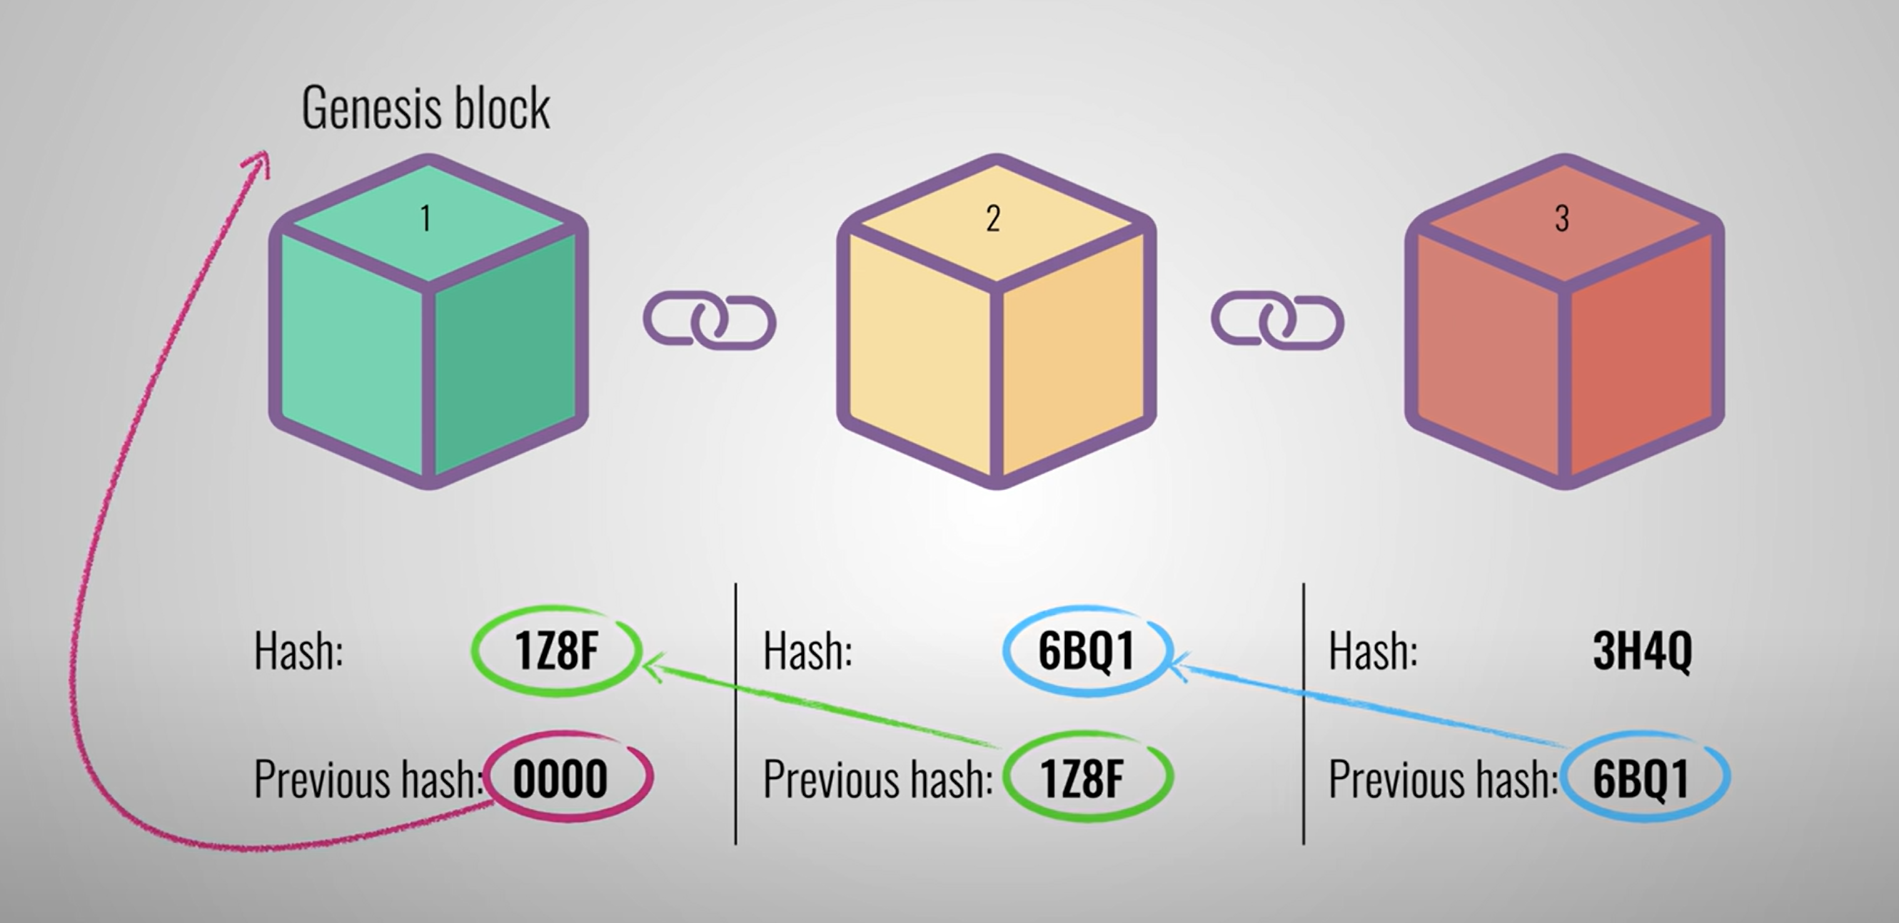
Blockchain
Data is grouped into blocks and connected in a chain-like structure.
Each block contains a cryptographic hash of the previous block, creating an unbreakable link.
Notes:
Because the information is shared and verified by multiple participants (called nodes) rather than controlled by a single authority, it is tamper-resistant, trustworthy, and difficult to alter once recorded.

Slide 11
.
Transparency
Efficiency
All transactions are recorded
on a secure ledger.
Stakeholders can trace operations easily.
Reduces the need for intermediaries.
Speeds up transaction processing and verification..
Blockchain
Security
Trust and Accountability
Data is encrypted and tamper-proof.
Reduces risks of fraud and unauthorized access.
Every participant has access to the same verified data.
Encourages responsible behavior among suppliers and partners.
Notes:
https://www.youtube.com/watch?v=SSo_EIwHSd4&t=22s

Slide 12
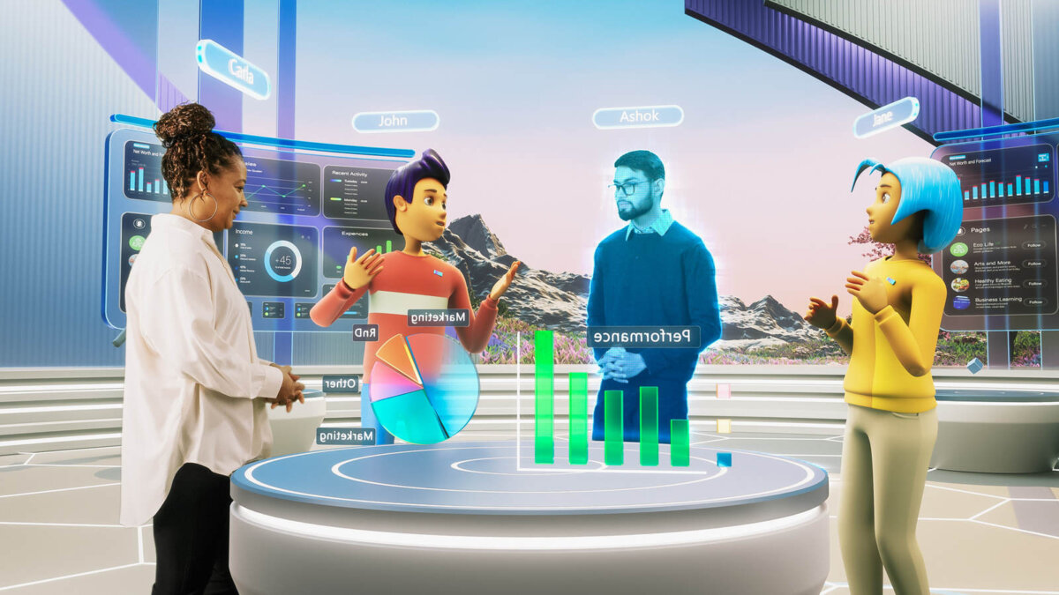
Metaverse
The Metaverse is a shared, virtual 3D space where people can interact with each other and digital objects in real time using technologies like Virtual Reality (VR), Augmented Reality (AR), and the internet.

Slide 13
.
Immersive Experience
Training and Simulation
Enables interactive, 3D experiences for customers.
Enhances engagement and brand loyalty.
Provides realistic, risk-free environments for employee training.
Improves learning outcomes and skill development.
Metaverse
Remote Collaboration
New Revenue Streams
Allow employees to meet together globally.
Reduces travel costs and improves teamwork..
Supports virtual products, services, and events.
Opens opportunities for innovative business models.

Slide 14
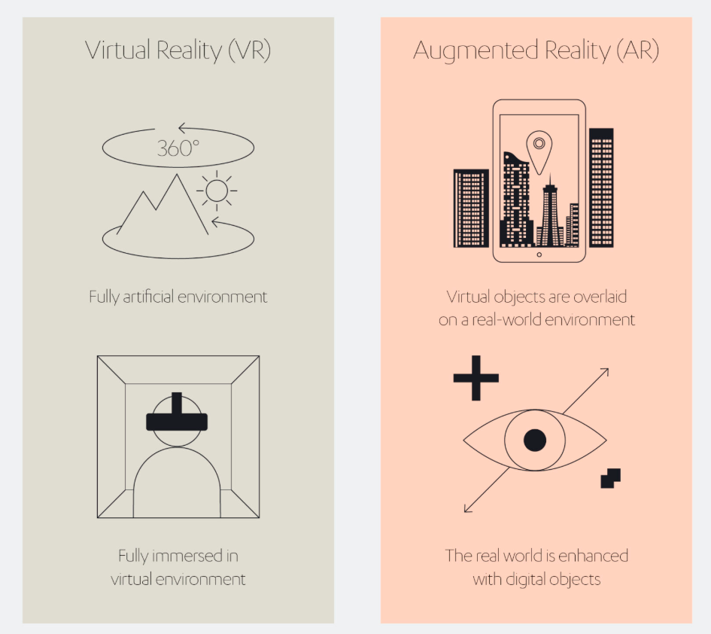
AR /VR
.
Virtual Reality is a fully immersive digital environment that replaces the real world with a simulated one. Users wear VR headsets to experience and interact with 3D virtual spaces as if they were physically present there.
Augmented Reality overlays digital information (like images, sounds, or text) onto the real-world environment through devices such as smartphones, tablets, or AR glasses.
Notes:
AR example: https://www.youtube.com/watch?v=LZ0IoPyUvSg

Slide 15
.
Customer Engagement
Remote Collaboration
Provides interactive product demos or virtual try-ons.
Improves user experience and brand loyalty.
Teams can interact in virtual spaces, improving communication.
Bridges geographical barriers for global operations
AR/ VR
Immersive Training
Marketing and Innovation
Simulates real-world scenarios for training.
Reduces costs and risks associated with on-the-job training.
Enables innovative campaigns and experiences.
Differentiates brand and attracts tech-savvy customers.

Slide 16
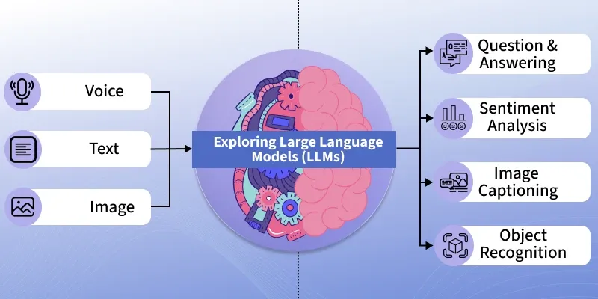
A Large Language Model is an artificial intelligence system trained on massive amounts of text data to understand, generate, and respond in human-like language.

Slide 17
.
Knowledge Accessibility
Decision Support
LLMs make complex information easy to access and understand by summarizing, or explaining content in natural language..
LLMs analyze large volumes of text data (such as policies, feedback, or reports) to identify insights, trends, and recommendations for data-driven decisions
LLMs
Productivity Enhancement
Innovation and Personalization
They automate routine communication tasks — from drafting reports and coding to customer support — freeing humans for higher-level creative work.
By learning from vast data sources, LLMs enable new forms of personalized services — such as adaptive education, customized content creation, and intelligent tutoring system

Slide 18


Ethical View
1
Why IT Ethics Matter.
Technology
influences
decisions and
human lives.
Decision-makers often underestimate long-term implications.
Ethical IT
management
ensures
responsibility
and fairness.
Ethics: what is good or bad; moral duty and obligation.
2
Myth of Amoral Computing.
Morals: personal beliefs shaped by culture, religion, upbringing.
Computers perceived as incapable of moral judgment.
Users deflect responsibility to technology.
Managers must own ethical outcomes of design and deployment.
Law: formalized rules that may lag societal ethics.

Slide 19
Deepfake
1
Work in groups
What are the ethical implications?
What are the tools used to detect it?
Watch this video:
Deepfake Example
What is deepfake

Slide 20
THANK
YOU!

